Slide 1
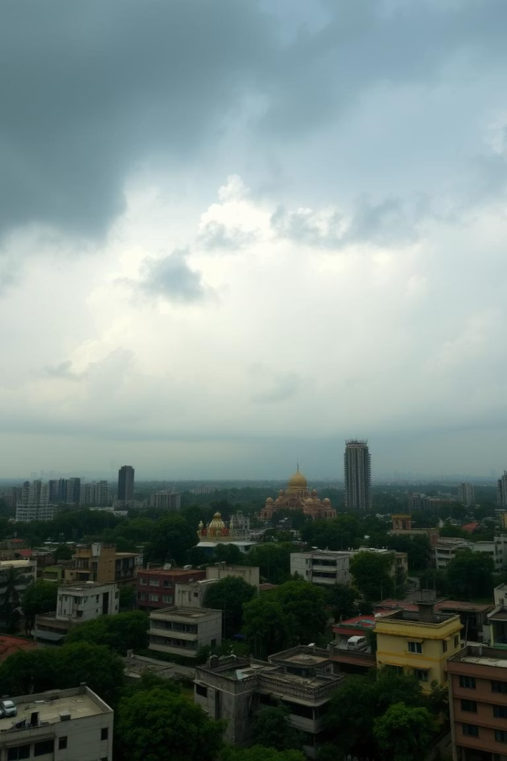
Rain Prediction Using Machine Learning
This project predicts rainfall using historical weather data of Delhi with machine learning.
Indian Institute of Information Technology, LUCKNOW
Presented by:
ANJALI(MSA24016)

Slide 2
Project Objective and Dataset
Objective
Dataset
Predict rain (1) or no rain (0) from weather data using binary classification.
Delhi weather CSV containing temperature, wind speed, sunshine, rain sum, etc.
Random Forest Classifier chosen for modeling.

Slide 3

Data Cleaning & Preprocessing
Date Conversion
Normalization
Converted 'time' to datetime; extracted month, day, weekday.
Converted sunshine duration from seconds to hours.
Target Creation
Created 'will_rain' column; 1 if rain_sum > 0, else 0.

Slide 4
Feature Selection for Training
Numerical Features
Time-Based Features
Max temperature
Month
Min temperature
Day
Sunshine duration
Weekday
Wind speed
Target: Binary will_rain output

Slide 5
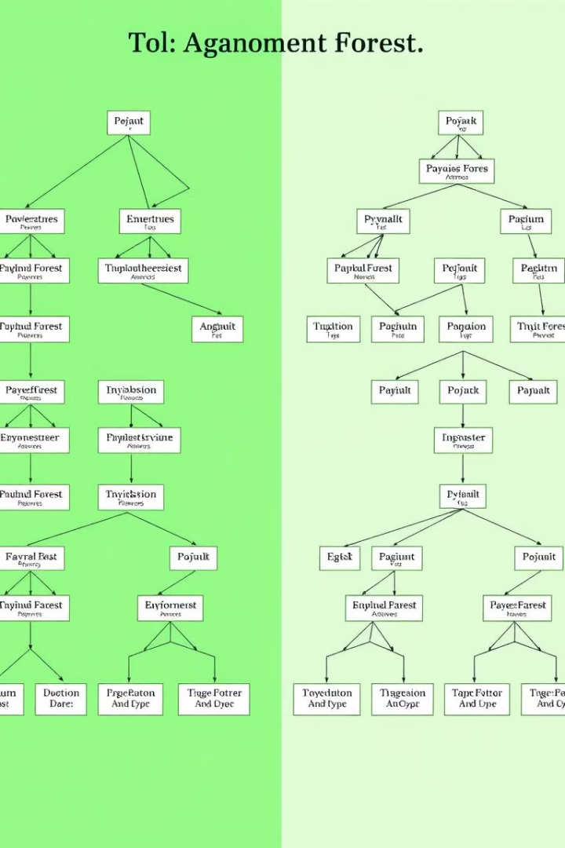
Model Training Setup
1
Data Split
2
Feature Scaling
80% training data, 20% testing data.
Applied StandardScaler to standardize features.
3
Random Forest
Used 100 decision trees for classification.

Slide 6
Model Evaluation Techniques
Metrics Used
Evaluation Tools
Accuracy
Confusion Matrix for TP, TN, FP, FN
Precision
ROC AUC score to measure model quality
Recall

Slide 7
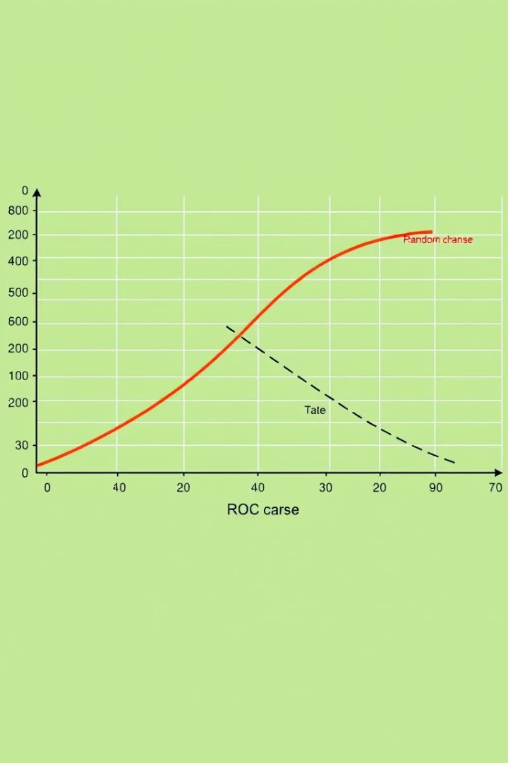
Understanding the ROC Curve
ROC Insights
ROC plots trade-off between true positive rate and false positive rate.
AUC Interpretation
AUC closer to 1 indicates better classification performance.

Slide 8
Results and Model Performance
Performance Summary
Improvement Scope
Random Forest produced decent accuracy in rain prediction.
Model can improve with larger datasets and hyperparameter tuning.

Slide 9

Applications and Use Cases
Practical Uses
Decision Support
Useful for real-time weather prediction applications in agriculture and transport.
Helps planners react effectively to expected rainfall events.

Slide 10


Conclusion and Next Steps
Key Points
Future Directions
Random Forest provides a valid framework for rain prediction.
Expand dataset scope, tune parameters, integrate more features.
Thank You

